Slide 1

Office Rental Service
Capstone Project Defense
Supervisor: Mr. Nguyễn Trọng Tài
Members : Lê Xuân Tiến
Nguyễn Vũ Hoàng Quốc
Trương Tiến Thành
Trần Lê Tuấn

Slide 2
Contents
Current Situation
Proposed Solution
Project Features
Search Office - Request Appointment - Create Contract
Request Office
Extend and Return contract
Request Rental/ Repair
Statistic and Management
Pros and Cons
Future Development
Notes:
Chia lại luồng search – appointment, accept – contract - extend contract, Repair request,

Slide 3
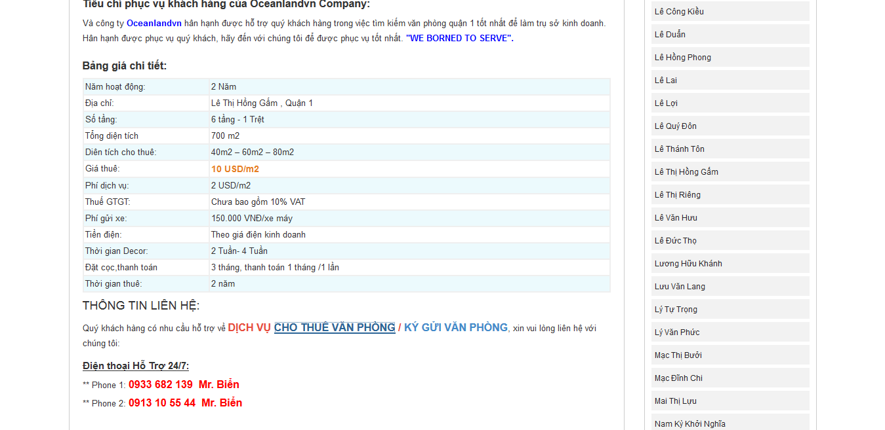
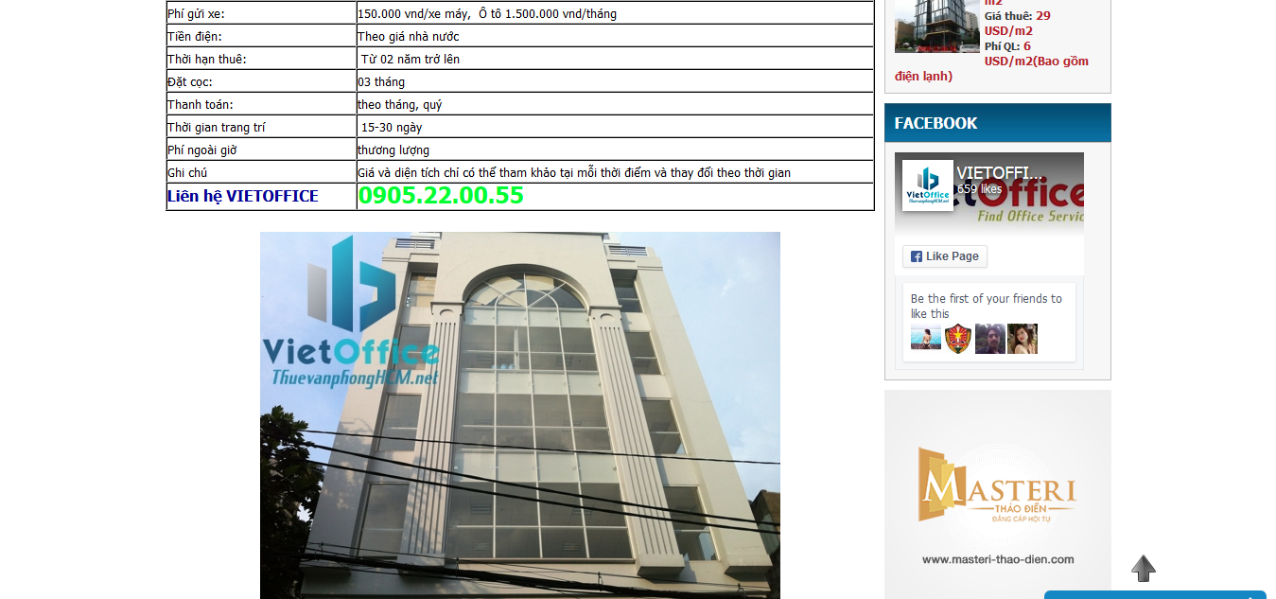
Current Situation
There are a lot of office rental websites in Vietnam but most of those websites only provide information of offices.
Lack of customer service.
Managing contracts manually.
http://vanphonggiatotchothue.com
http://www.vanphongchothuequan1.com.vn
Notes:
customer service: appointment, rental and repair service

Slide 4







Proposed Solution
Contact with
Manager
Owner
Manage
Belong to
Contact with
System
Customer
Assign
Office
Contact with
Staff
Notes:
customer service: appointment, rental and repair service

Slide 5
Proposed Solution
There are two ways to

Slide 6
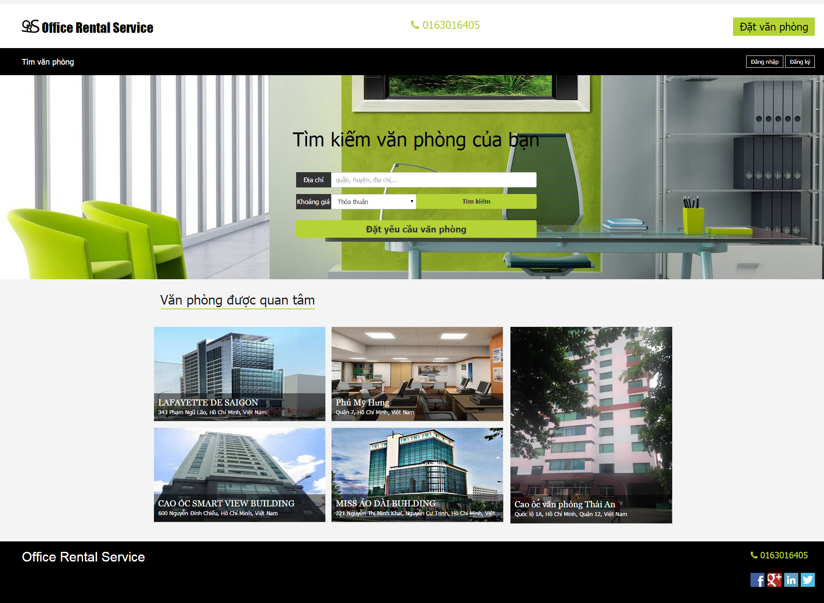
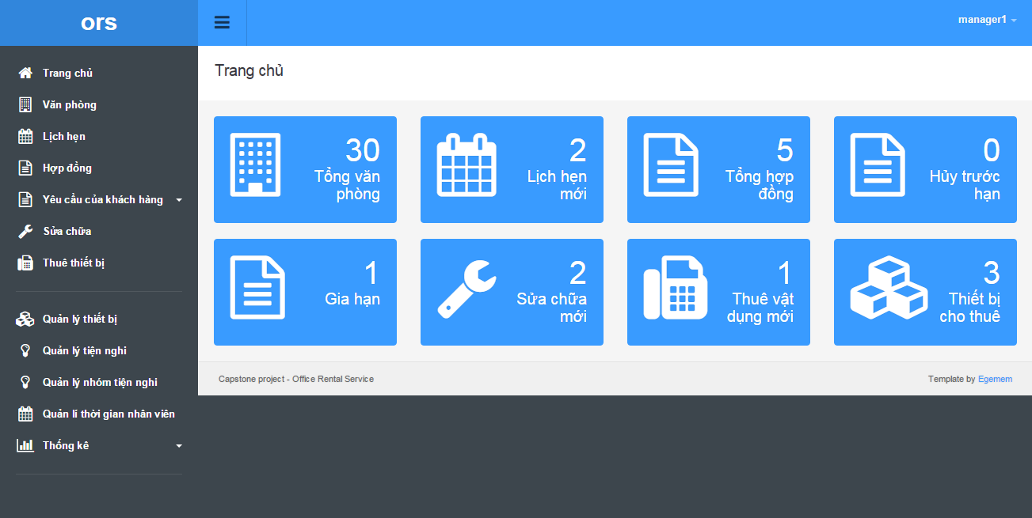

Proposed Solution
Search office
Manage office
Customer
Manager
Request office
Schedule request
Request appointment
Manage appointment
Back office
Website
Staff
Create contract
Manage contract
Request repair/ rental
Manage repair/ rental
Check appointment
Staff
Check assigned request
Mobile

Slide 7

Project Features Search Office - Request Appointment - Create Contract
(5) Meet and check office
(6) Decide create contract
Customer
Staff
(1) Choose an office
(4) Assign to staff
(2) Create appointment
System
(8) Create Contract
Contract
(3) Go to appointment
(7)
Manager

Slide 8
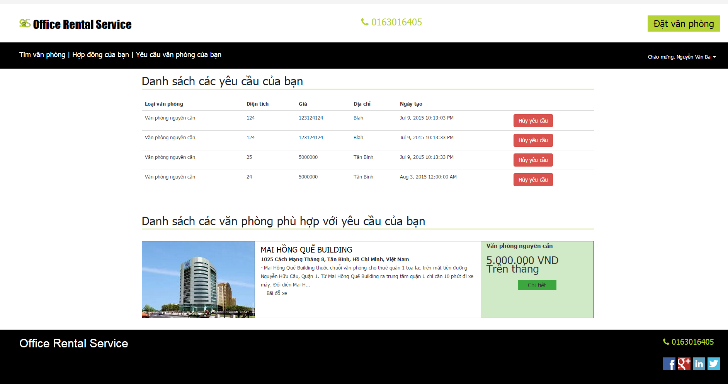


Project Features Request Office
(5) Check request
(1) Create request
Customer
Result page
(2) Schedule check
(4) Send email
System
(3) Return data
Database
Customer’s email

Slide 9
Project Features Request Rental/Repair
(7) Accept/Reject
(6) Meet customer
(7) Done
Staff
Customer
(4) Send SMS
(5) Accept/Reject
(1) Send request
(3) Assign
(2) Check
Manager
System
Notes:
Trong lúc kh sử dụng vp, kh có nhu cầu sửa chữa thiết bị hoặc khi kh muốn thuê thêm vật dụng thì họ có thể gửi yêu cầu lên hệ thống của chúng tôi. Sau khi kh gửi yêu cầu, người quản lý sẽ kiểm tra yêu cầu đó rồi giao việc cho nhân viên. Hệ thống sẽ tụ động gửi 1 tin nhắn báo cho khách hàng biết ngày nhân viên đến sửa chữa hoặc giao vật dụng. Nv sẽ đến kiểm tra xem yêu cầu đó có chính đáng ko. Nếu chính đáng thì nv sẽ chấp nhận, nếu yêu cầu đó phi lý thì nv sẽ từ chối. Sau khi thực hiện yêu cầu, kh sẽ xác nhận lại với nhân viên. Nếu kh ko hài lòng thì người quản lý sẽ giao cho nhân viên khác xử lý.

Slide 10
Project Features Extend and Return contract
(1) Send request
Customer
System
(2) Check, then Accept or cancel request
Manager

Slide 11






Project Features Management
Request
Appointment
Rental
Manager
Contract
Statistic
Rental item
Amenity

Slide 12
Project Features Management
Admin
User

Slide 13
Pros and Cons
Pros:
Providing search engines criteria: price, location, amenities...
Providing full information about the office. Support map for customers.
Making an appointment easily.
Manage contract easily.
The customer’s requests are automatically suggest by system.
Helping staff easily to manage and update their jobs by mobile application.

Slide 14
Pros and Cons
Cons:
Owner of the office must contact us to post their information.
The function of notification system is limited.
Only in Ho Chi Minh city.

Slide 15
Future Development
Mobile application for customer.
Owner can create and manage their office.
Extend system for different locations.

Slide 16
Q&A

Slide 17
K-Means Algorithm

Slide 18
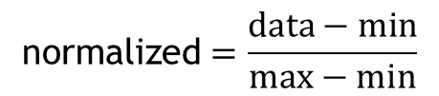
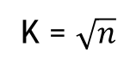
K-Means Algorithm
Start
K = $\sqrt{n}$
Calculate K
$$\text{normalized}=\frac{data−min}{max−min}$$
Normalize data
Group data in K groups

Slide 19
K-Means Algorithm
Start
Calculate K
Normalize data
Group data in K groups
Yes
Group changed?
Calculate the mean of each group
Group based on minimum distance to mean
No
End

Slide 20
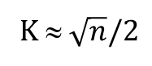
KNN Algorithm
Start
Calculate K
K ≈ $\sqrt{n}/2$
Normalize query point
Calculate min K distance from query point to sample points
More than 1 most frequency
Yes
Return min distance group
No
End

Slide 21
Suggest Schedule
Start
Init schedule
Unassigned job
Suggest assign day (?)
Available staff in assign day?
No
Yes
Suggest assign to staff which have least jobs
Yes
Still have unassigned job
Update schedule
No
End

Slide 22
Thanks for your listening

